Slide 1
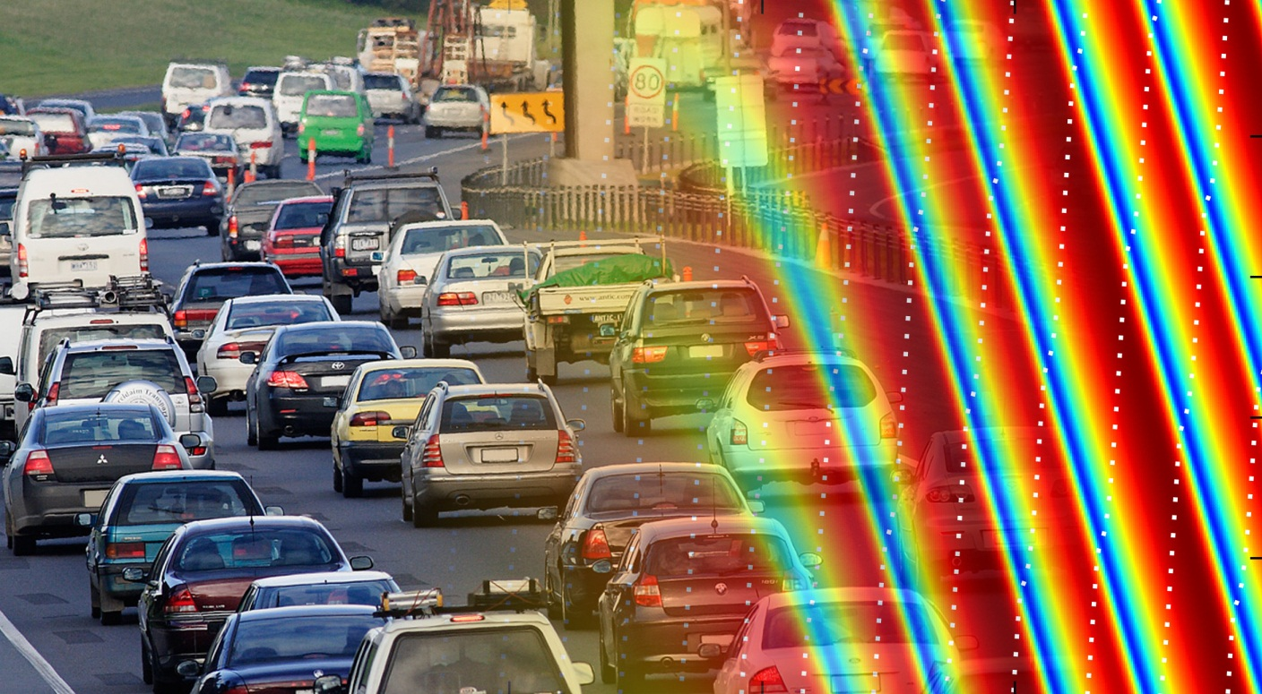
Phase transition in the Intelligent Driver Model induced by interaction exponent

Slide 2
Overview

Slide 3
Introduction

Slide 4
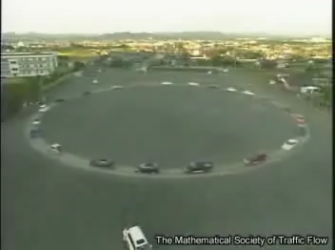
Experimental observation of instability
Nakayama et al. New Journal of Phys. 2009

Slide 5
Intelligent Driver Model
Section2 ODE

Slide 6
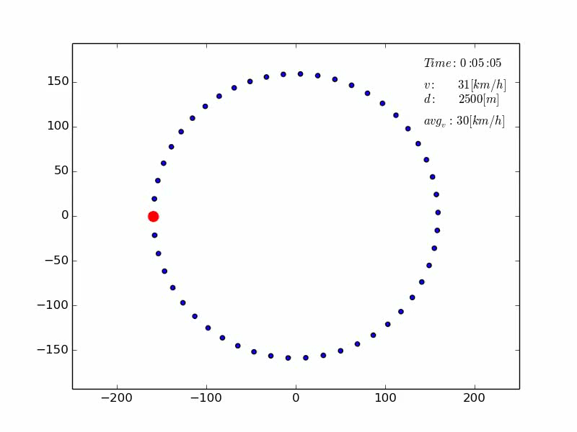
Simulated traffic instability

Slide 7
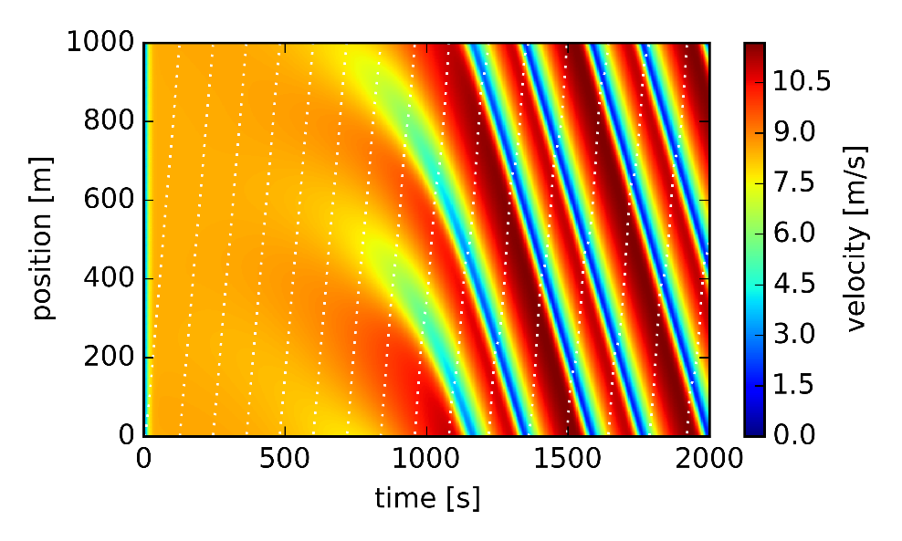
Simulated traffic instability

Slide 8
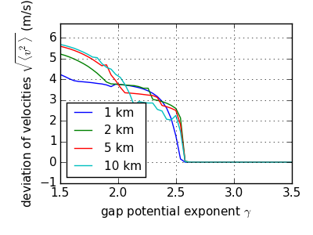

Interaction exponent $γ$
Section2 ODE (gamma highlight)
Increase gamma suppresses instabilities
Critical gamma , measure for instabilities: variance of velocity

Slide 9
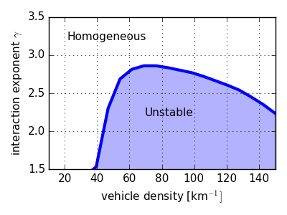
Interaction exponent $γ$
Section2 ODE (gamma highlight)
Phase diagram: additional parameter is vehicle density

Slide 10


Interaction exponent $γ$, but why?
Instabilities can be enhanced by allowing high decelerations
High gamma encourages hard decelerations aswell!
How come we still see better stability?!

Slide 11
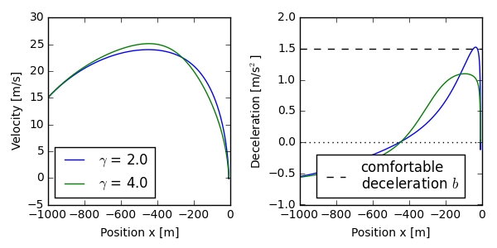
Breaking behaviour
Breaking profiles when approaching standing obstacle
Low gamma driver breaks late and hard
High gamma driver breaks earlier
Information about obstacle spreads faster to other drivers

